Slide 1
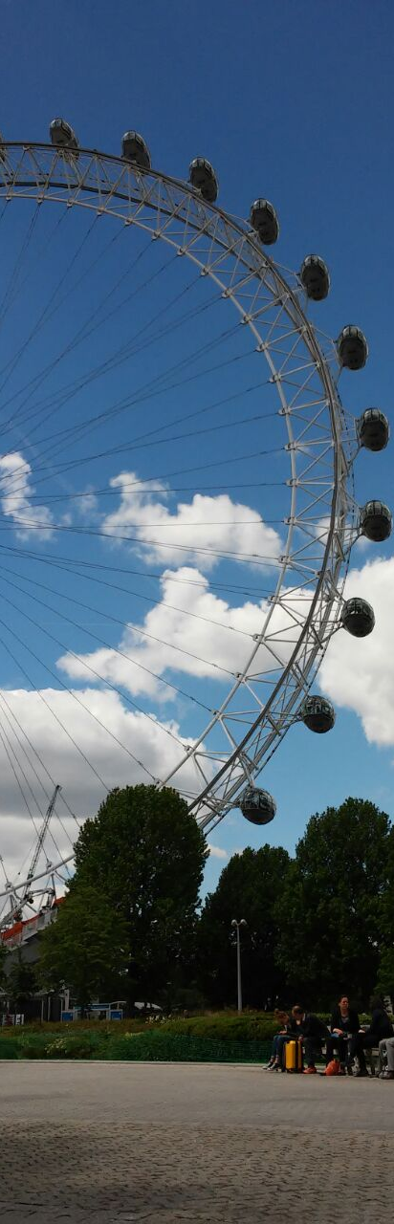
AI Hackathon Municipal Challenge

Slide 2

Image SLide
Our Vision
Reactive
Proactive

Slide 3

Preprocessing

Slide 4
Preprocessing
Add relevant data
Merge and clean data
Spatial data has a lot of significance -> crawl coordinates from GovIL
Some events are weather realted (more Gezem after windy days etc.) -> add rain, wind and temperatures
Focus on Acco (initially ~135K events)
Similar/inconsistent categories (“אדם חשוד” vs. “אדם חשוד – שיטור עירוני”) -> merge based on Jaccard similarity.

Slide 5
Proposed ModelS

Slide 6
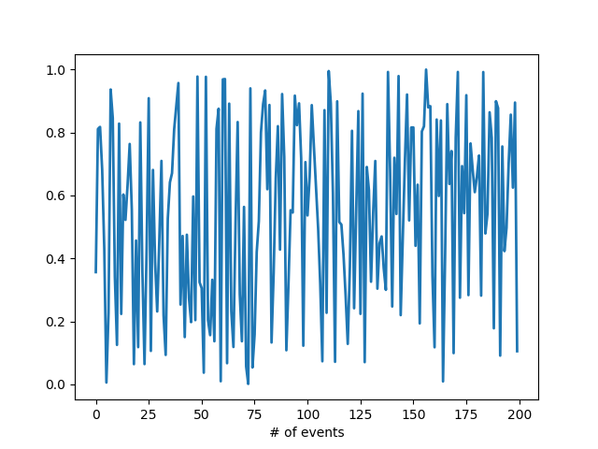
Number of events
Recurring events
Geographic Info
Events happening daily are sparse and much harder to predict
However, the number of events that could occur on the same week could be more substantial
Adding priors about days that the event is more probable to occur in, we can approximately predict when a certain event may happen
Event counts are recurring
We can utilize count history in order to predict the future
A possible parameter is “how far back” our model remembers
Events probably correlated with locations
Utilize location to predict event happening
See which areas are more prone to certain events
Add capabilities of automatic call routing given location and arriving at problematic area ahead of time
Model “memory”
# of events
week

Slide 7
Current Products

Slide 8
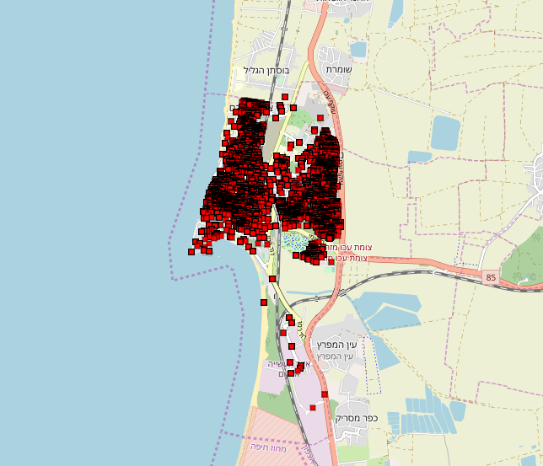
Events On Map – All Between 2015 and 2018

Slide 9
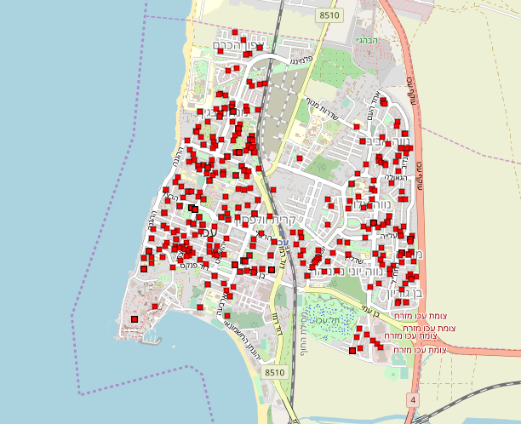
Events On Map – one Month

Slide 10
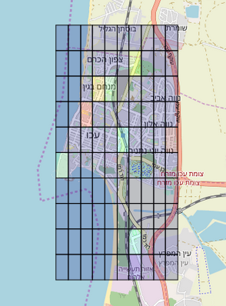
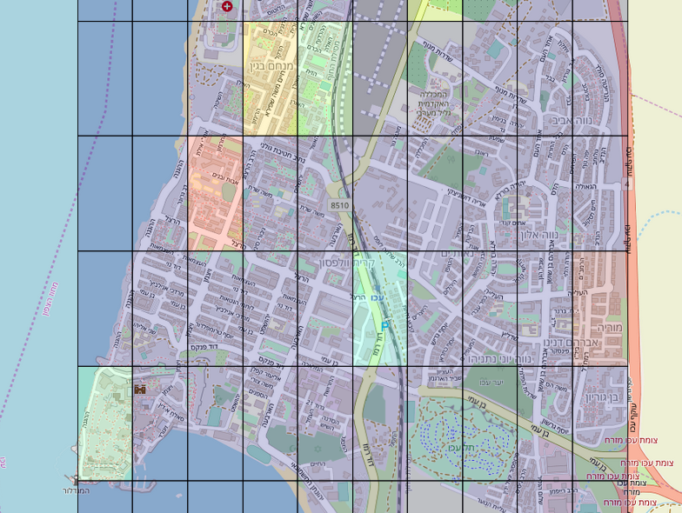
Live Heat map prediction model

Slide 11
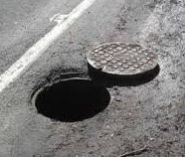
prediction model
features
Prediction!
grid
events

Slide 12
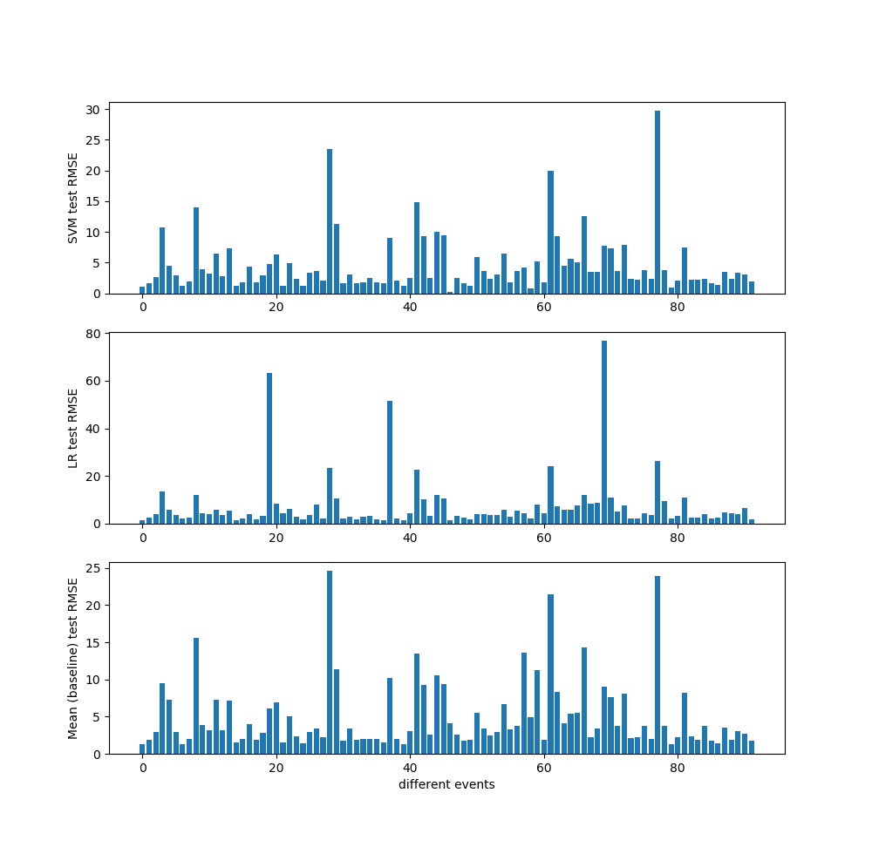
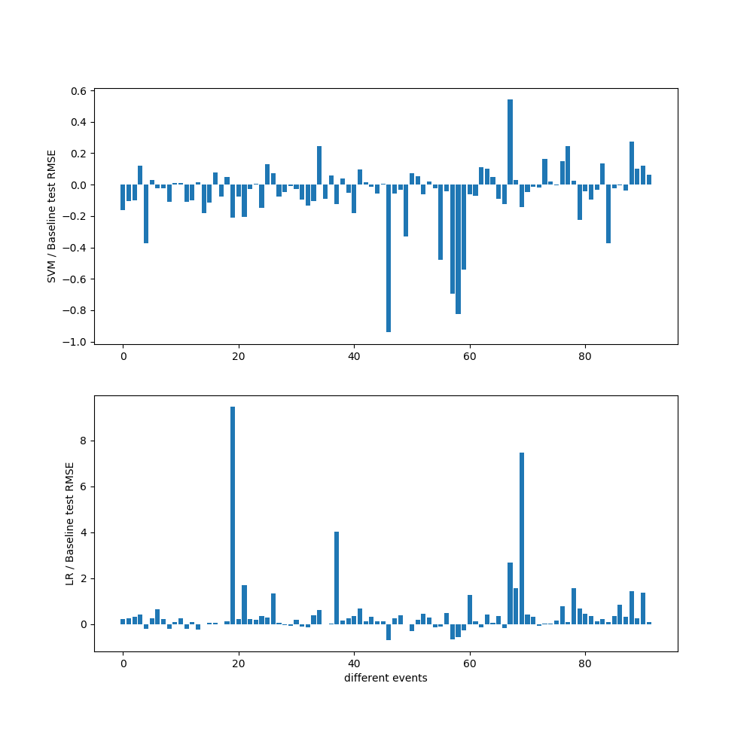
Model Quality (RMSE)

Slide 13
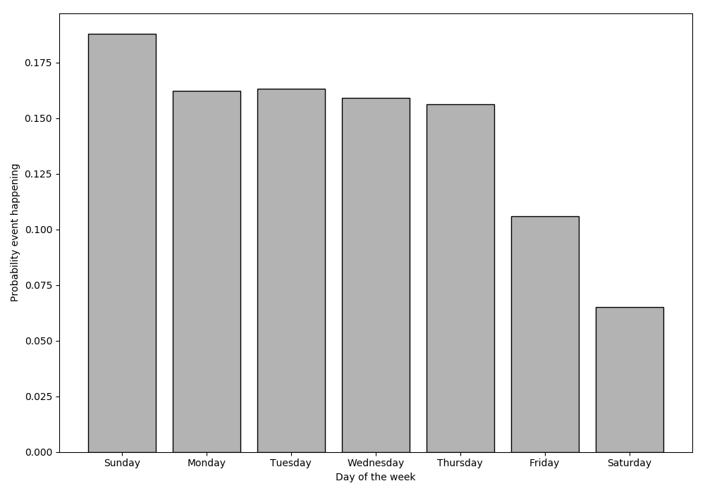
Event conditional on weekday

Slide 14
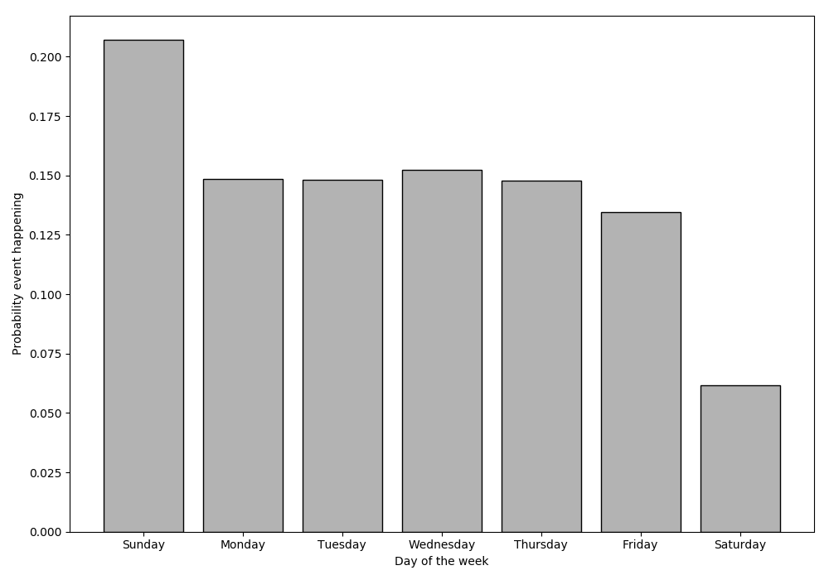
How events distribute over days
סתימת ביוב
Notes:
ויש כאלו שהיינו מצפים שיתפלגו אחיד אבל לא לגמרי. בשבת יש הרבה פחות פניות (גם כשמוציאים דברים של מחשוב, פקחים וכו')

Slide 15
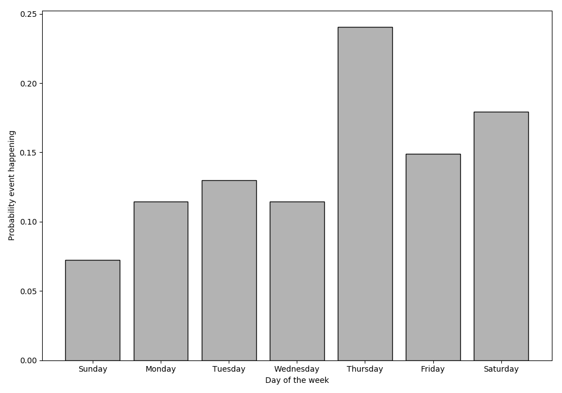
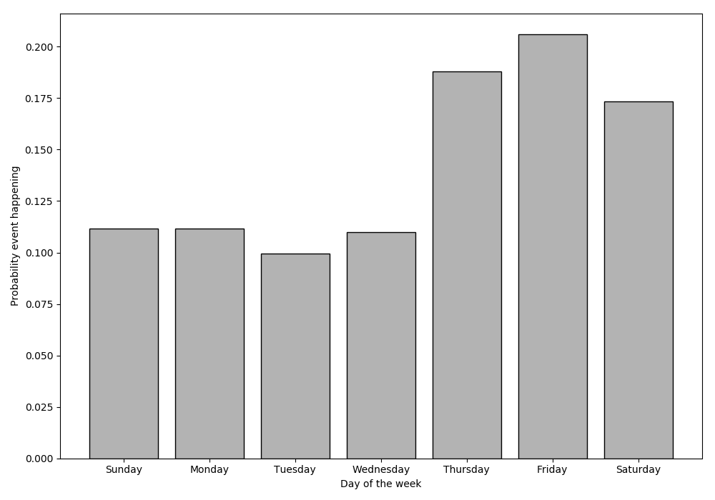
How events distribute over days
קריוקי
מוסיקה רועשת
Notes:
יש דברים שכמצופה קורים יותר בסופ"ש

Slide 16
Looking ahead

Slide 17
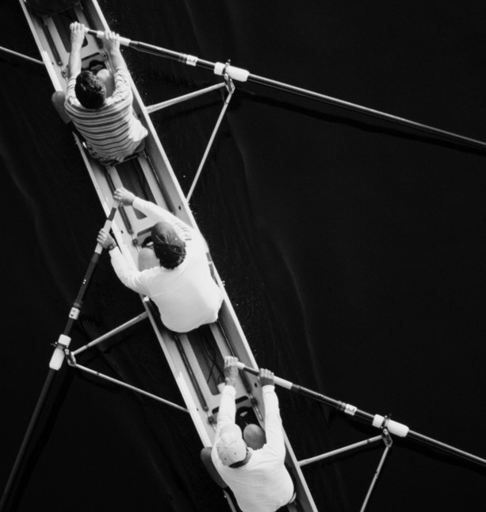
Future Leads
Use counts between different event types and utilize their correlations
Add additional data from the National Bureau of Statistics to correlate between different events
Look into more sophisticated time series models for more accurate predictions
Use models in other municipalities

Slide 18
THANK YOU

